Slide 1

Internet of Things
(IoT)
Transforming the Future

Slide 2

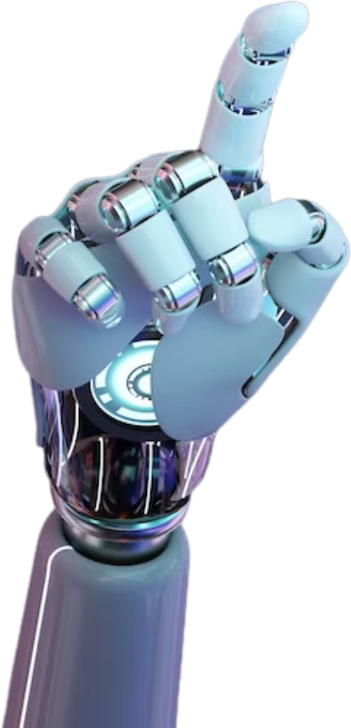
02
thynk unlimited
What is Iot
A network of connected devices that link and share data with the cloud and other IoT devices is known as the internet of things, or IoT. IoT devices can be both digital and mechanical machines as well as consumer goods. They are usually embedded with technology, such as sensors and software.

Slide 3
02
Importance of Iot
IoT encompasses more than just physical device connections to the internet; it also plays a role in human daily activities. such as:
  Efficiency
  Reduces Costs
  Enhances Quality of Life
  Improves Safety and Security
  Automation

Slide 4
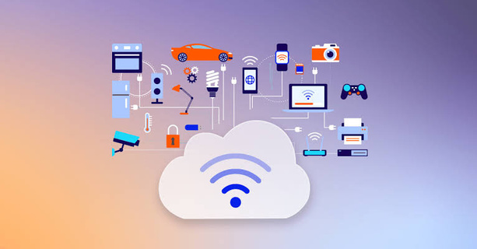
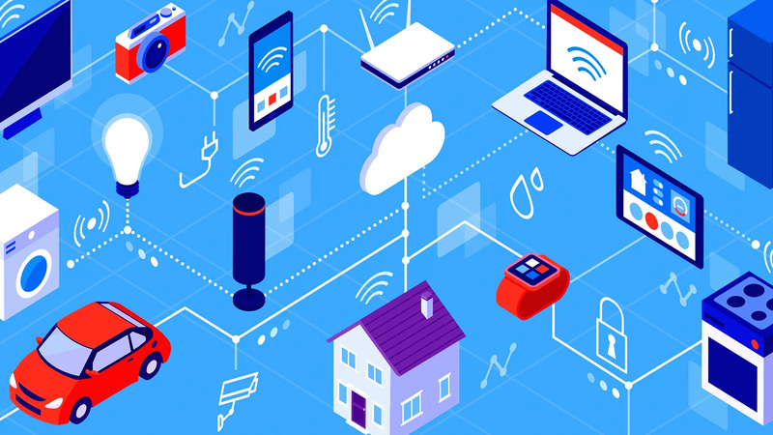
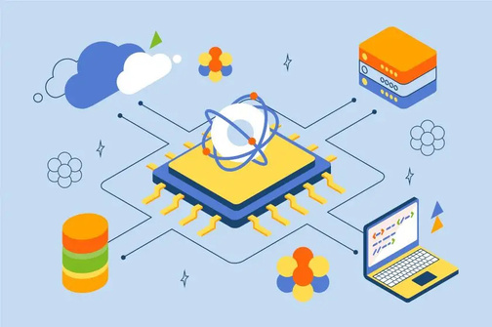
Evolution of IoT
03
The Internet of Things (IoT) evolved from early experimental novelties—such as Carnegie Mellon’s web-connected soda machine in 1982—into a massive global infrastructure that officially surpassed the human population in connected devices by 2009. Coined by Kevin Ashton in 1999 around RFID supply chain tracking, the concept accelerated through the 2010s as smartphone proliferation, cheap sensors, and cloud computing fueled a boom in consumer smart home ecosystems and Industrial IoT (IIoT) factory automation.

Slide 5
Types of IoT
04
CONSUMER IOT (CIOT)
INDUSTRIAL IOT(IIOT)
COMMERCIAL IOT
used in manufacturing, energy, and logistics, among other industrial sectors. It links supply chain logistics, heavy machinery, and factory automation systems to track asset health, anticipate equipment failures, and streamline production lines.
focuses on commonplace home or personal applications. Examples include wearable technology (fitness trackers, smartwatches), home security systems, and smart home appliances (smart thermostats, connected lights).
Utilized in enterprise, retail, and public spaces to improve operational efficiency and customer experience. Examples include smart building automation (HVAC and lighting systems), automated checkout systems, digital signage, and asset tracking in warehouses.

Slide 6
Types of IoT
04
INFRASTRUCTURE AND SMART CITIES (PUBLIC IOT)
INTERNET OF MEDICAL THINGS (IOMT) / HEALTHCARE IOT
AGRICULTURAL IOT (AGRI-IOT)
Deployed across municipal environments to manage public resources and infrastructure. Examples include smart grids for energy management, adaptive traffic control systems, smart waste management sensors, and structural health monitoring for bridges and roads.
Used for medical and health monitoring purposes. Examples include remote patient monitoring devices, smart pills, connected pacemakers, and real-time hospital asset tracking systems.
  Deployed in farming environments to automate and optimize agricultural practices. Examples include soil moisture sensors, weather tracking stations, automated irrigation systems, and livestock tracking tags.

Slide 7
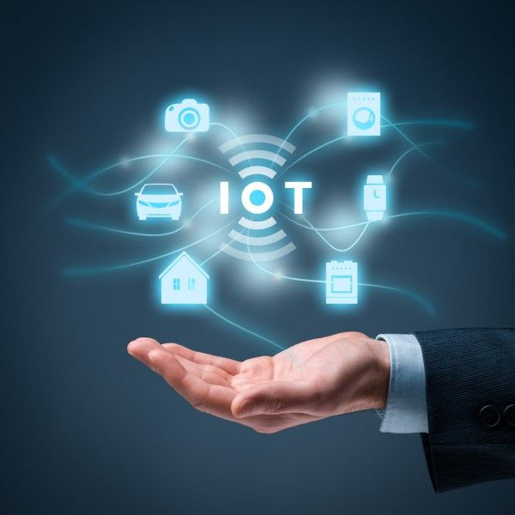
05
Early Milestones of "IoT"
  1982 (The First "Thing"): Computer scientists at Carnegie Mellon University connect a Coca-Cola vending machine to check drink availability and temperature remotely.
  1990–1991: John Romkey creates the first internet toaster; Cambridge researchers deploy the Trojan Room coffee pot camera.
  1999 (The Official Name): Kevin Ashton officially coins the phrase "Internet of Things" during a supply chain presentation at Procter & Gamble regarding RFID tracking.

Slide 8
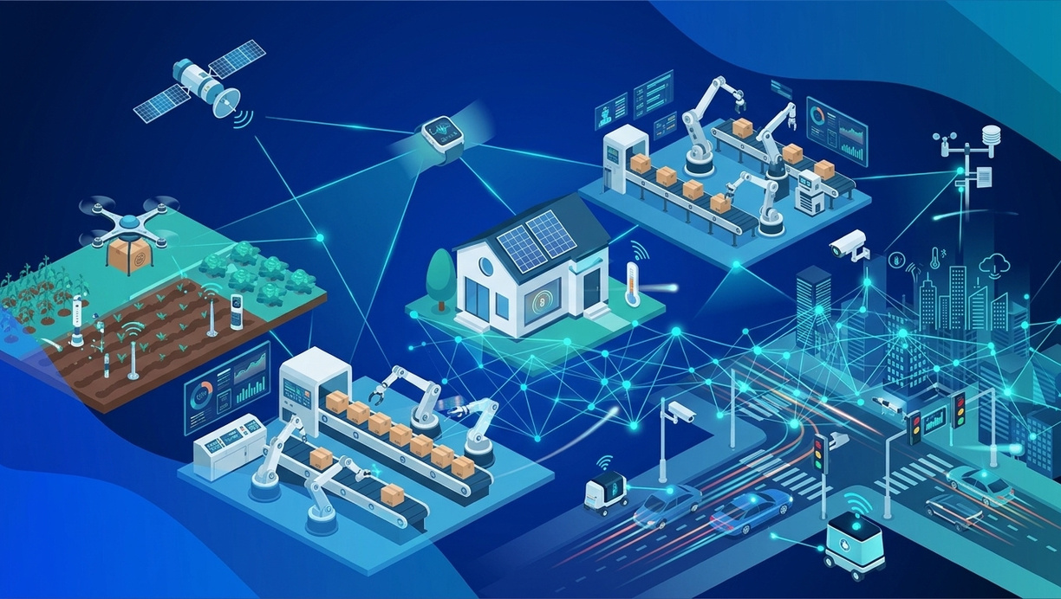
06
Internet of Things platform
An IoT platform manages device connectivity. It can be a software suite or a cloud service. The purpose of an IoT platform is to manage and monitor hardware, software, processing abilities, and application layers.
Sensor technologies
IoT sensors, sometimes called smart sensors, convert real-world variables into data that devices can interpret and share. Many different types of sensors exist. For example, temperature sensors detect heat and convert temperature changes into data. Motion sensors detect movement by monitoring ultrasonic waves and triggering a desired action when those waves are interrupted.

Slide 9
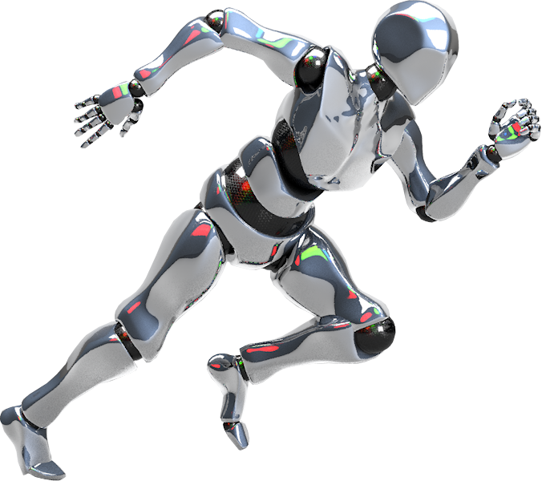
Challenges of IoT
07
  Security & Privacy: Vulnerability to cyberattacks, data breaches, and unencrypted device communications.
  Interoperability: Lack of universal standards across different hardware and software vendors.
  Scalability: Managing network bandwidth and storage for billions of connected devices.
  Future Trend: Integration with Artificial Intelligence (AIoT) for autonomous decision-making at the edge.

Slide 10
Thank
You!

